Slide 1


Chapter 4
Attitudes, Values, and Ethics
Explain the ABC model of an attitude.
Describe how attitudes are formed.
Identify sources of job satisfaction and commitment.
Distinguish between organizational citizenship and workplace deviance behaviors.
Identify the characteristics of the source, target, and message that affect persuasion.
Discuss the definition and importance of emotions at work.
Contrast the effects of individual and organizational influences on ethical behavior.
Identify the factors that affect ethical behavior.
Learning Outcomes

Slide 2

Learning Outcome
1
Explain the ABC model of an attitude

Slide 3


Attitude
a psychological tendency expressed by evaluating an entity with some degree of favor or disfavor
Should poor performance be blamed on “bad attitude”?
Notes:
2

Slide 4

Beyond the Book:
Bad Attitude
Larry Johnson is a highly accomplished football player for the Kansas City Chiefs – a former number one pick, a two-time Pro Bowl participant, and one of the most accomplished running backs in 2005 and 2006.
In 2007 and 2008, Johnson had two relatively unproductive, injury-marred seasons. And yet, it was his attitude, not his productivity, that led to his release the Chiefs. Constant complaints about salary, personal attacks on the coach, slurs against homosexuals, mocking fans, charges of abusing women – all of these actions insured that Johnson would no longer be welcome in the Kansas City organization.
Notes:
There is no doubt that Larry Johnson was a talented and productive running back. In his final college season at Penn State University, he broke the storied 2000 rushing yards mark. In 2005, he had an extraordinary season for the Kansas City Chiefs, rushing for 1750 yards, good for third in the entire league, in just nine games. He followed up in 2006 with 1789 yards and 17 touchdowns, leading the league with 416 rushing attempts. In November 2009, however, this star was unceremoniously dumped by the Chiefs. While a drop in performance during the 2007 and 2008 seasons was certainly a factor, most sportswriters and football officials agree that his attitude played a much bigger role. Whether it was complaining about his contract, making personal attacks against the head coach, or facing charges of abusing women, Johnson repeatedly displayed an antagonistic and confrontational attitude towards the organization and fans. Fan reaction to Johnson was so negative that an online petition to prevent Johnson from becoming the Chiefs all-time leading rusher – for which he needed only 74 more yards – collected over 34,000 signatures.
Sources: http://www.nytimes.com/2009/11/10/sports/football/10chiefs.html; http://www.pro-football-reference.com/players/J/JohnLa00.htm

Slide 5

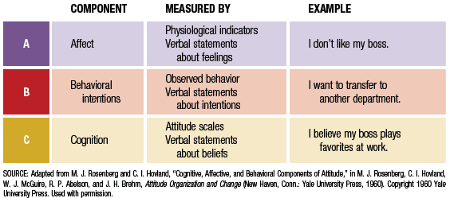
Model of an Attitude
B
A
C
© 2011 Cengage Learning. All rights reserved.
Notes:
3

Slide 6

Cognitive Dissonance
a state of tension that is produced when an individual experiences conflict between attitudes and behavior
Notes:
4

Slide 7
Learning Outcome
2
Describe how attitudes are formed.

Slide 8
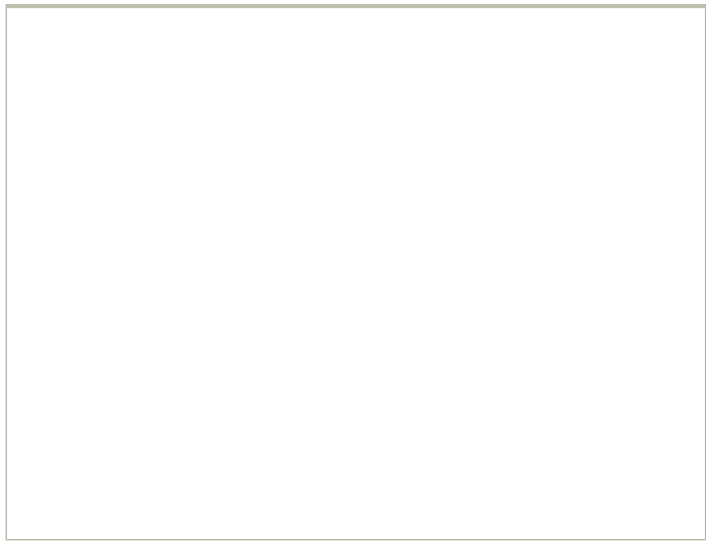

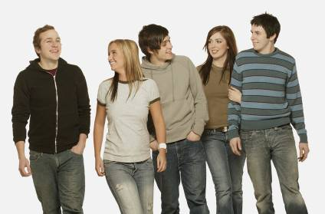
Two Influences on Attitude Formation
Direct Experience
Social Learning
Notes:
5

Slide 9


Learning by
Observing a Model
The learner must:
Focus on the model
Retain what was observed
Reproduce the behavior through practice
Be motivated
© 2011 Cengage Learning. All rights reserved.
Notes:
6

Slide 10
Attitude–Behavior Correspondence Requirements
Attitude Specificity
Attitude Relevance
Measurement Timing
Personality Factors
Social Constraints
Notes:
7

Slide 11
Learning Outcomes
3 & 4
Identify sources of job satisfaction and commitment.
Distinguish between organizational citizenship and workplace deviance behaviors.

Slide 12
Job Satisfaction
a pleasurable or positive emotional state resulting from the appraisal of one’s job or job experience
Notes:
8

Slide 13
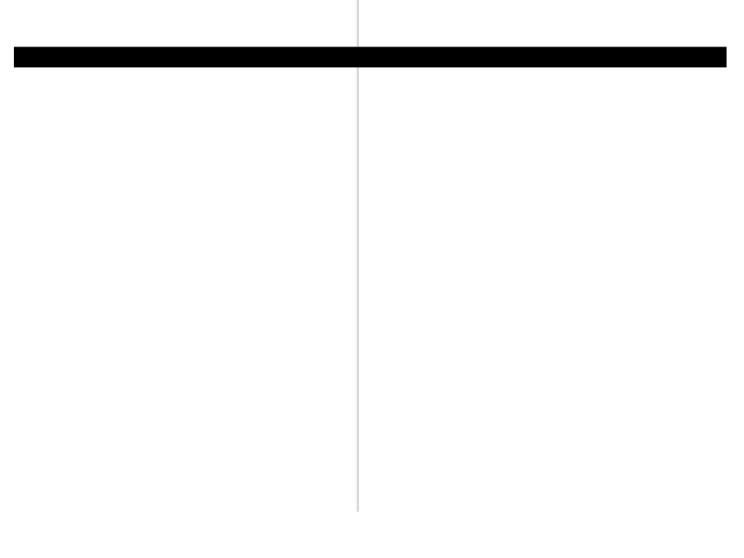

JOB (DIS)SATISFACTION
Most believe that happy or satisfied employees are more productive at work…
…but the relationship between job satisfaction and performance is more complex.

Slide 14
Work Attitudes
Organizational Citizenship Behavior
Job satisfaction
Workplace deviance behavior
Job dissatisfaction

Slide 15
Learning Outcome
5
Identify the characteristics of the source, target, and message that affect persuasion.

Slide 16
Process of Persuasion
Source
New Attitude
Persuasion
Target
Notes:
12

Slide 17
Characteristics
Source: expertise, trustworthiness,attractiveness
Target: high or low self-esteem?
Message: biased or balance?

Slide 18
Learning Outcome
6
Discuss the definition and importance of emotions at work.

Slide 19

JOB (DIS)SATISFACTION
[Positive Emotions]
[Negative Emotions]
Improve cognitive functioning
Improve health and coping mechanisms
Enhance creativity
Lead to workplace deviance.

Slide 20

EMOTIONAL CONTAGION
Emotional contagion is
the dynamic process
through which emotions are transferred
from one person to another. It occurs
primarily through nonverbal cues and
tendency for mimicry.

Slide 21
Learning Outcome
7
Contrast the effects of individual and organizational influences on ethical behavior.

Slide 22
Ethical Behavior
acting in ways consistent with one’s personal values and the commonly held values of the organization and society
Notes:
19

Slide 23
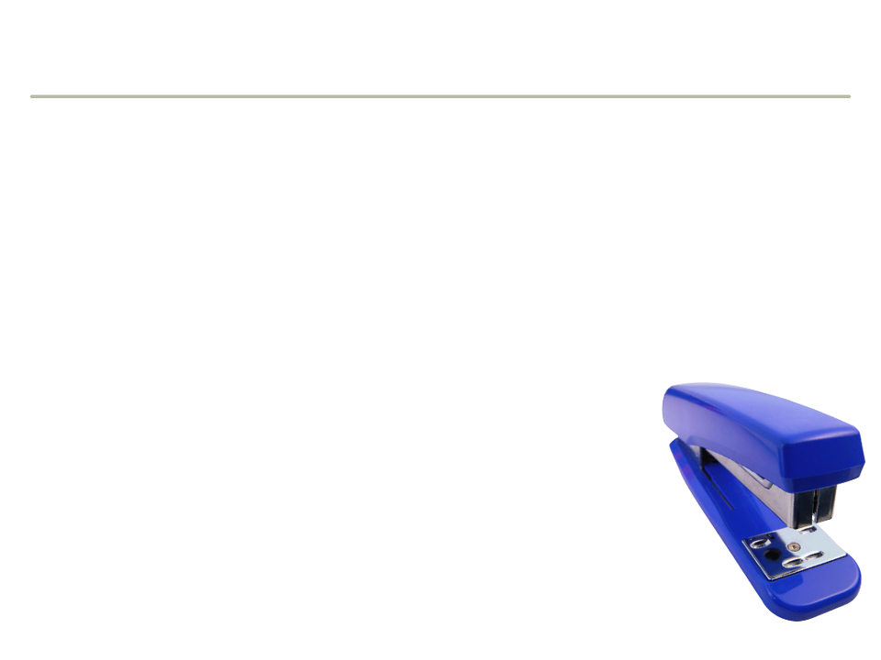
Ethics and the Workplace
Violations of the public trust are costly….
…But, doing the right thing can
have a positive effect on performance.
Notes:
20

Slide 24
Beyond the Book:
No Consequences?
On October 1, 2009 David Letterman announced that he had been having sexual affairs with junior members of his staff.
There appears, however, to be little fallout from the admission.
There has been no sanction or warning from CBS, and Letterman’s ratings are higher than ever.
Notes:
What began as an extortion attempt ended with a confession of sexual impropriety. On his October 1 2009 show, David Letterman announced that he had recently been a victim of an extortion attempt. An anonymous individual demanded $2 million, with the threat that he knew about awful things that Letterman had done. This prompted Letterman to announce to the TV and studio audience that he had been having sexual affairs with members of his writing and production staff. Though not illegal in a technical sense, these types of relationships are ethically questionable, since they could easily involve sexual coercion, favoritism and discrimination against those who were unwilling. While troubling, Letterman’s admission has had little effect on this career. CBS, the network that carries his show, has not condemned or sanctioned Letterman in any significant way. What is more, Letterman’s ratings are higher than ever; for the first time in 14 years, his show is number one in its time-slot, beating out the Tonight Show with Conan O’Brien.
Can individuals get away with violating ethics? Should Letterman face some organizational punishment? Does his role – essentially, he owns the show – prevent any sort of punishment?
SOURCE: http://www.nytimes.com/2009/10/02/business/media/02extort.html?_r=1

Slide 25
Learning Outcome
8
Identify the factors that affect ethical behavior.

Slide 26
Values
enduring beliefs that a specific mode of conduct or end state of existence is personally or socially preferable to an opposite or converse mode of conduct or end state of existence.
Notes:
14

Slide 27



Ethics and the Individual
Ethical decision making requires three qualities of individuals
Competence to identify ethical issues and
evaluate the consequences of alternate actions.
Self-confidence to seek out different
opinions and decide what is right.
Willingness to make decisions when there
is no unambiguous solution.

Slide 28
Values
Instrumental – values that represent the acceptable behaviors to be used in achieving some end state.
Terminal – values that represent the goals to be achieved, or the end states of existence
Notes:
15

Slide 29
Work Values
Influence individual’s perceptions of right and wrong in the workplace.
Achievement
Concern for others
Honesty
Fairness
Notes:
16

Slide 30

Cultural Differences in Values
Doing business in a
global marketplace often
Means encountering a
clash of values among
different cultures.
Notes:
17

Slide 31
Locus of Control
  [Internal]
  belief in personal control and personal responsibility
  [External ]
  belief in control by outside forces (fate, chance, other people)
Generally, internals make more ethical
decisions than externals.

Slide 32
Machiavellianism
a personality characteristic indicating one’s willingness to do whatever it takes to get one’s own way
Notes:
24

Slide 33
Machiavellianism
  [High-Machs]
  better to be feared than loved; the ends justify the means.
  [Low-Machs ]
  value loyalty and relationships; concerned with other opinions.

Slide 34
Cognitive Moral Development
The process of moving through stages of maturity in terms of making ethical decisions
Level I – Premoral Level
Stage 1 – avoid punishment
Stage 2 – serve immediate interest
Level Il – Conventional Level
Stage 3 – live up to
friends’ expectations
Stage 4 – observe
societal laws
Level llI – Principled Level
Stage 5 – principles of
justice/right
Stage 6 – self-selected
ethical principles
Notes:
25

Slide 35
Beyond the Book:
Where Does Kiva Money Go?
Kiva is an organization that promises individuals that they will be able to make micro-loans directly to entrepreneurs in emerging economies.
As discovered by David Roodman, a fellow at the Center for Global Development, people in fact cannot make direct loans through Kiva; there is no person-to-person connection.
Money “lent” through Kiva’s website goes to microlending organizations, and not individual lenders.
Notes:
At the heart of Kiva’s marketing campaign is the promise that individuals in the US can personally take action in the global fight against poverty. Featuring various entrepreneurs from emerging economies, Kiva’s web site presumably allows people from the US to make a direct loan to finance a business venture in, say, Viet Nam or Afghanistan. Such a personal connection between individuals lies at the heart of the organizational values that Kiva espouses: “Kiva's mission is to connect people through lending for the sake of alleviating poverty. Kiva is the world's first person-to-person micro-lending website, empowering individuals to lend to unique entrepreneurs around the globe.” But as David Roodman discovered, Kiva’s actual practices may not mesh with these values. As Roodman found out, individual lenders do not make direct loans to any of the people features on Kiva’s web site. Instead, their money finances third-party financial institutions. What is more, these institutions charge a high amount of interest, some nearing 40%, while the individual lenders do not receive any interest.
SOURCE: http://www.nytimes.com/2009/11/09/business/global/09kiva.html; http://www.kiva.org/about

Slide 36
1. Does William Hundert describe a specific type of life that one
should lead? If so, what are its elements?
2. Does Sedgewick Bell lead that type of life? At what level of cognitive moral development do you perceive Sedgewick Bell?
3. What consequences or effects do you predict for Sedgewick Bell
because of the way he chooses to live his life?
The Emperor’s Club
Notes:
William Hundert (Kevin Kline), a professor at Saint Benedict’s prep
school, believes in teaching his students about living a principled life and classical literature.
The behavior of a new student, Sedgewick
Bell (Emile Hirsch), causes Hundert to suspect that he leads a less than
principled life. In this scene, set years later, Hundert is a guest at the
estate of Sedgewick Bell (Joel Gretsch).
Ask your students:
1. Does William Hundert describe a specific type of life that one
should lead? If so, what are its elements?
2. Does Sedgewick Bell lead that type of life? Is he committed to any
specific ethics view or theory?
3. What consequences or effects do you predict for Sedgewick Bell
because of the way he chooses to live his life?

